Slide 1
House Price Prediction: An End-to-End Machine Learning Approach
Leveraging data science for accurate property valuation

Slide 2

Table of contents
Introduction & Problem Statement
Data Loading & Initial Exploration
Exploratory Data Analysis (EDA)
Data Preprocessing & Feature Engineering
Model Training & Selection
Model Evaluation
Conclusion

Slide 3
Introduction & Problem Statement
The dataset contains detailed information about each house,including physical attributes and
location-based features,with 79 explanatory variables describing (almost) every aspect of residential
homes in Ames,Iowa.
Objective: To accurately predict residential home prices based on a diverse set of features,to predict the sale prices for each house.
Tools used for Analysis: Python(Pandas, Numpy, Matplotlib, Seaborn)
Steps Involved:
Exploratory Data Analysis (EDA) - Handled missing values and outliers ,Visualized data distributions and feature correlations
Data Preprocessing - Encoded categorical variables, Scaled numerical features,Split data into training and test sets.
Model Building - Trained various regression models: Linear Regression, Ridge, Lasso, Decision Tree, Random Forest, etc. ,Used cross-validation for model evaluation,Compared performance metrics (MAE, RMSE, R²).
Model Evaluation - Identified the best model based on accuracy and generalization,Visualized actual vs predicted prices

Slide 4
Getting Started

Slide 5
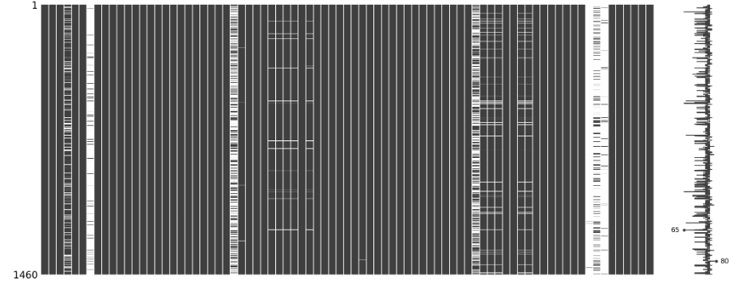
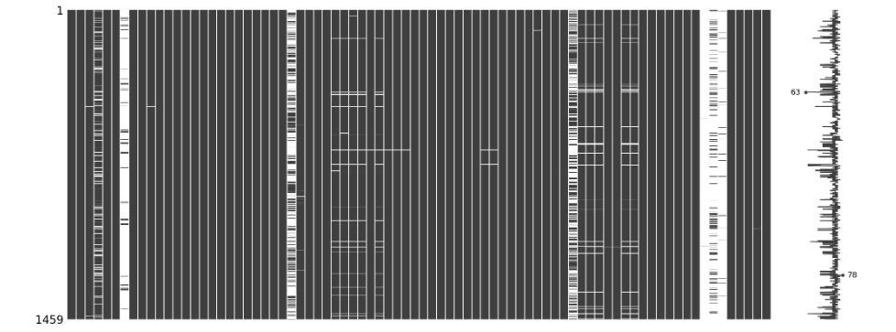
Data Loading & Initial Exploration
Initial Observation –
Presence of various data types (numerical, categorical).
Identification of missing values in several columns.
Wide range in values for numerical features.
There are no duplicate values present in the dataset.
Missing values present -
Train set – 7829
Test set – 7878
Train set: Test set:

Slide 6
Exploratory Data Analysis (EDA)
Understanding Saleprice : Sale price is our target variable ,we observed that the distribution of saleprice is slightly right-skewed, we need transformation.
Numerical features :
Histograms and KDE plots to visualize distributions.
Identified skewed features that might benefit from transformation.
Detected potential outliers.
Visuals :
Histograms /KDE plot of Saleprice.
Histograms of few key numerical features.
Scatterplot of Saleprice vs. GrLivArea.
Correlation Matrix:
Identified features highly correlated with SalePrice (such as, OverallQual, GrLivArea, GarageCars).
Identified highly correlated independent features (potential multicollinearity).
Categorical features:
Used box plots and bar plots to understand the relationship between categorical features and SalePrice (such as, Neighbourhood vs. SalePrice) .

Slide 7
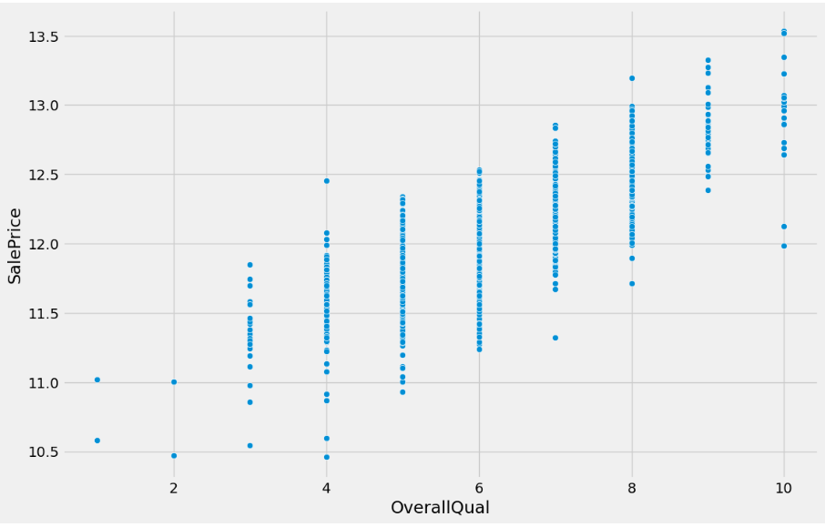
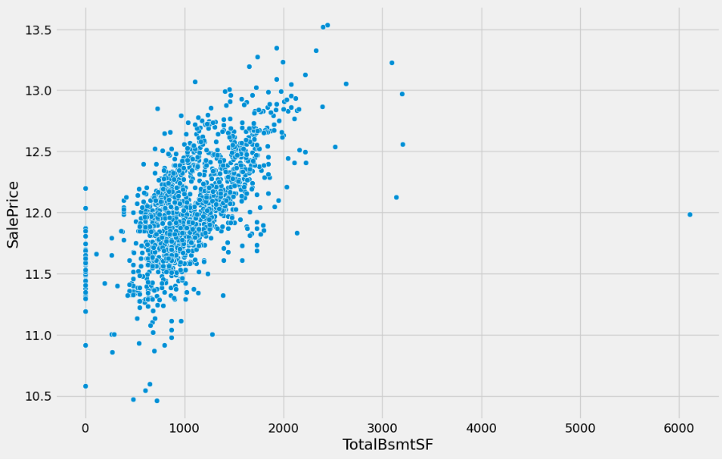
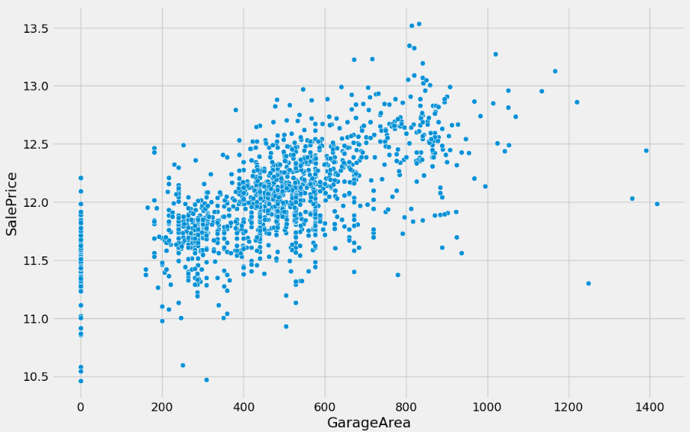
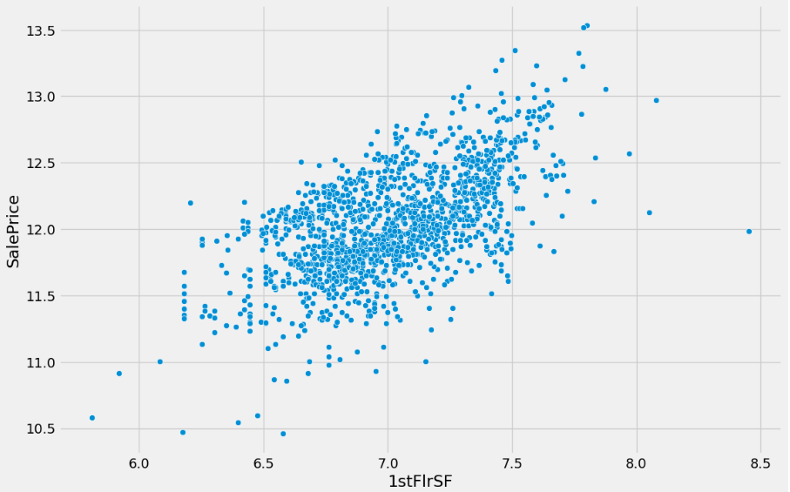
Relationships and Correlations (Part 1)
Saleprice vs OverallQual
Saleprice vs GarageArea
Saleprice vs TotalBsmtSF
Saleprice vs 1stFlrSF

Slide 8
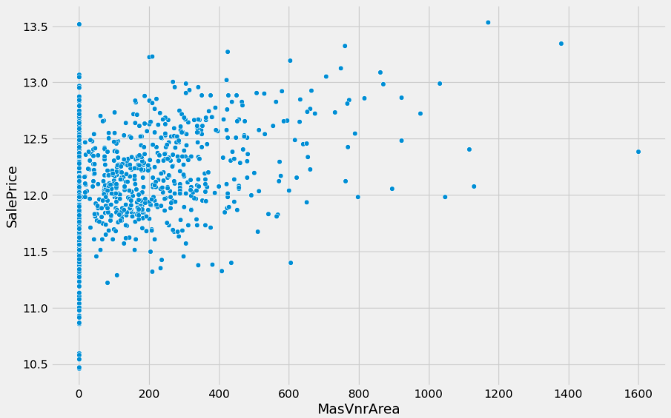
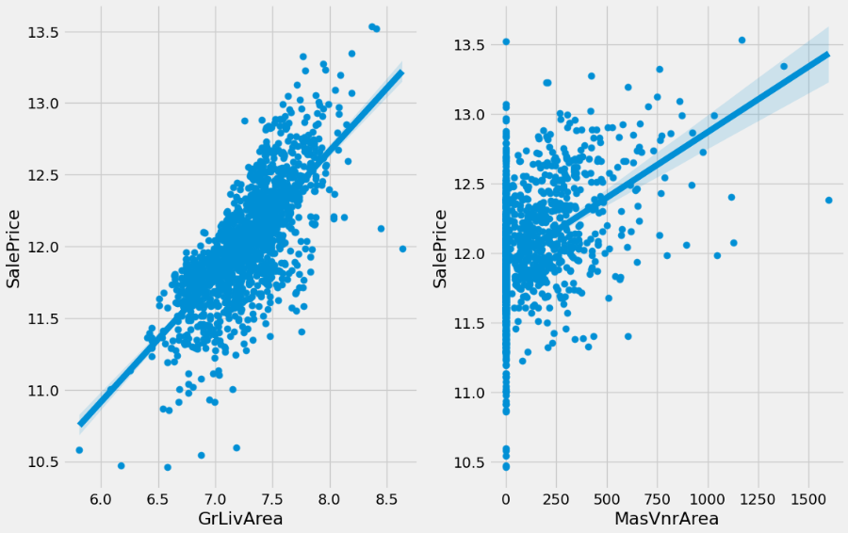
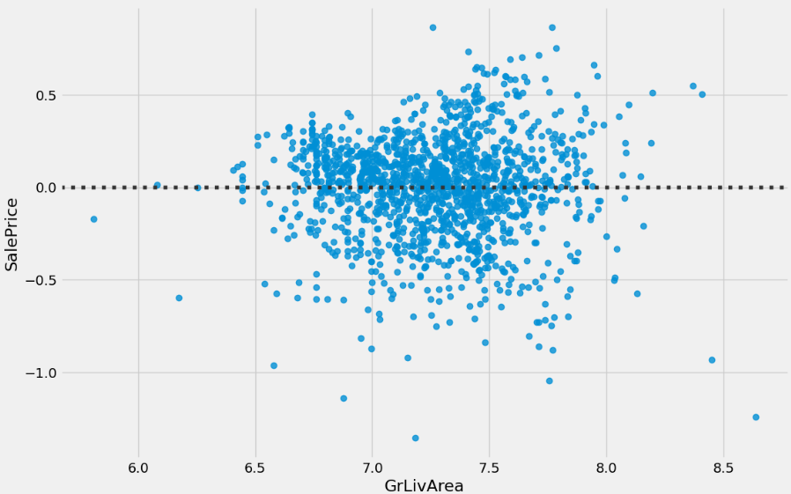
Relationship and Correlations (Part 2)
SalePrice vs MasVnrArea
Saleprice vs GrLivArea
SalePrice vs MasVnrArea and SalePrice vs GrLivArea

Slide 9
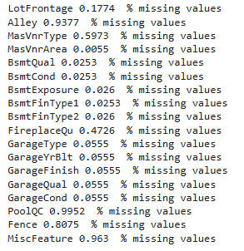
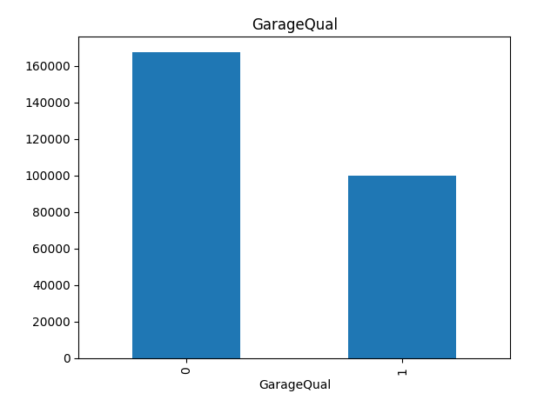
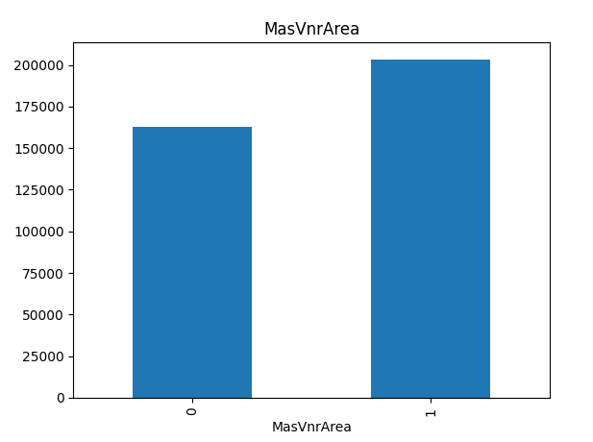
Data Preprocessing & Feature Engineering
Handling Missing Values:
Applied different approaches for different types of missing values.
For numerical values imputation used mean, median, or 0 and
for categorical imputation used mode and ‘None’ or ‘No’.
Dropped columns with a very high percentage of missing values
(as they offer little insight).
Created a table , summarizing missing value counts and the imputation
strategy for a few key columns.
Showing an example of visualization of the relation between the missing values and the dependent variable (Saleprice):

Slide 10
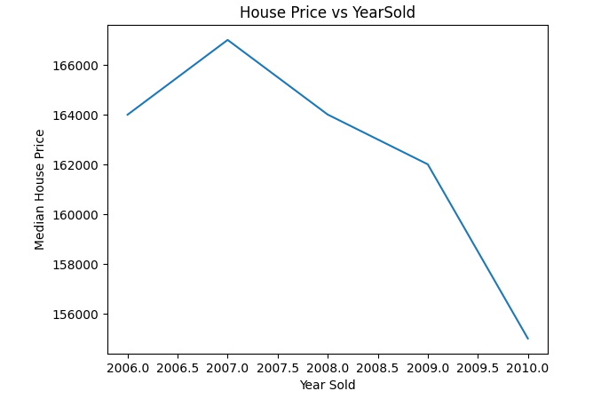
Transforming features:
Log Transformation :
Applied np.log1p to highly skewed numerical features (including sale price) to achieve a more normal distribution.
Categorical Encoding:
Converted categorical features into numerical format for model imputation.
One-Hot Encoding for creating binary columns for each category.
Creating new features:
Combined existing features to create more informative ones (such as,TotalSF from 1stFlrSF, 2ndFlrSF, BsmtFinSF1).
Derived age-related features.
Visuals :
Histograms of SalePrice (original vs log-transformed)
Simple diagram illustrating one-hot encoding for a categorical variable.

Slide 11
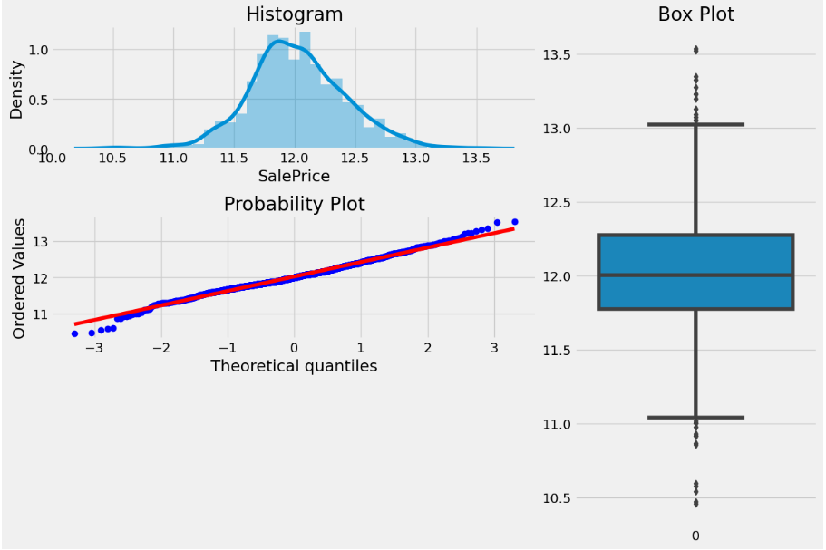
SalePrice – Observed saleprice distribution is often right-skewed , applied log transformation.

Slide 12
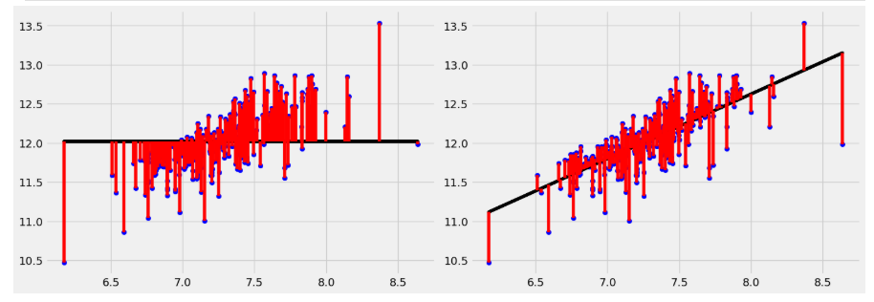
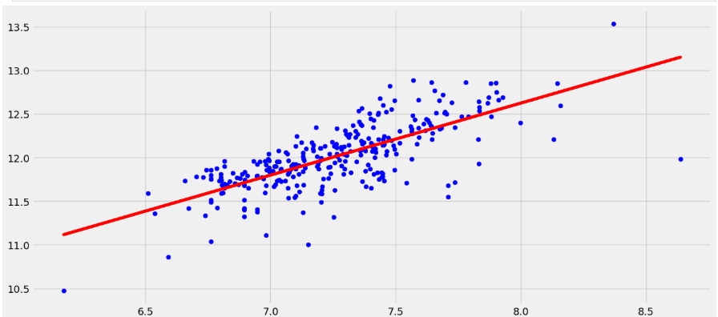
Building the Predictive Engine
np.log1p
np.log1p
np.log1p
np.log1p
np.log1p
np.log1p
np.log1p
Model Training
Split the combined data (train and test) for consistent preprocessing, then separated back for training and final prediction.
Trained models on the preprocessed training data.
Model Evaluation
Evaluation Metrics: Root Mean Squared Error(RMSE), R-Squared (R2 score)
RMSE: The primary metric for this dataset, represents the standard deviation of the residuals (prediction errors). Lower RMSE is better.
R2-Score: Indicates the proportion of the variance in the dependent variable that is predictable from the independent variables. Higher R2 is better.
Result: Present the RMSE and R2 scores obtained on the validation/test set.

Slide 13





Model Selection
Gradient Boosting
Linear Regression
Ridge Regression
Lasso Regression
Random Forest
Ensemble methods like Gradient Boosting and Random Forest are effective for this type of regression
problem.

Slide 14
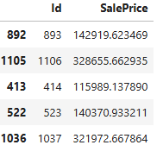
The Machine Learning Algorithm that perform the best was GradientBoostRegressor (MAE=0.08,MSE=0.014,R2_Score=0.91,RMSE=0.12)
Submission

Slide 15
Thank you
Thank you for your time
Github link: https://github.com/UrmesthaMondal/Data_Analysis_projects

